Slide 1
CUSTOMER RELATIONSHIP MANAGEMENT
CONCEPTS AND TECHNOLOGIES
Chapter 6
CRM and Customer Experience

Slide 2
Customer experience defined
Formal: Customer experience is the cognitive and affective outcome of the customer’s exposure to, or interaction with, a company’s people, processes, technologies, products, services and other outputs
Informal: If you were to ask your customers, ‘What is it like doing business with us?’ their answers would be descriptions of their customer experience.

Slide 3
The experience economy
Stages of economic development
EXTRACT COMMODITIES
MAKE GOODS
DELIVER SERVICES
STAGE EXPERIENCES
Degree of customization
lowest
highest
Interaction with customers
none
Co-production
Price strategy
commodity pricing
unique price
Value added
none
massive

Slide 4
Attributes of services
Intangible-dominant
Inseparable
Heterogenous
Perishable

Slide 5
Classifying customer experiences 1
Planned vs. unplanned
  The planned customer experience differs from the unplanned because management tries to engage the customer in a positive and memorable way
Positive vs. normative
  The positive customer experience describes customer experience as it is. Normative customer experience describes customer experience as management or customers believe it ought to be.

Slide 6
Classifying customer experiences 2
Commodity vs. unique
  One experience of travelling to work on London Underground is much like another, but co-piloting a jet fighter to celebrate an important birthday would be, for most of us, a unique experience
Core product vs. value-add
  Customer experience as the core product: white water rafting, swimming with dolphins, feeding elephants, paragliding, bungee-jumping. Customer experience as value-add: charter flight vs. scheduled flight

Slide 7
Customer experience concepts
Touch point
  Touch points exist wherever customers come into virtual or concrete contact with a company’s products, services, communications, places, people, processes or technologies
Moment-of-truth
  Moments of truth occur during customer interactions at touch-points. These are the moments when customers form evaluative judgements, positive or negative, about their experience.
Engagement
  The customer’s emotional and rational response to a customer experience

Slide 8
Desired customer experience outcomes
Companies that consciously design customer experience want to evoke strong, positive engagement.
Such engagement might be expressed in a sense of confidence, integrity, pride, delight or passion

Slide 9
How to understand customer experience
Mystery shopping
Experience mapping
Process mapping
Customer activity cycle
Ethnographic methods
Participant observation
Non-participant observation

Slide 10
Experience map of a hotel guest
Make
reservation
Arrive at
hotel
Stay in
hotel
Leave
hotel
Park car
Check-in
Bags to
room
Greeting
Request
reservation
details
Swipe card
Register
Hand over
key
Thank you
What does the customer want to happen?
What should the receptionist do (process)?
What skills, knowledge, attitudes are needed (people)?
What technological support is required (IT)?

Slide 11
Citibank’s understanding of the customer activity cycle
Pre
1. One step on line
opening.
2. Instant Citicard
master
documentation
(one-time)
Update Banking
Needs
Open Bank
Account
1. Consulting
and advice
2. Relationship
management
deciding
what to do
Customer
Activity Cycle
(CAC)
Use Banking
Facilities
1. Integrated products
2. Individual pricing
3. One step access
ATMs (Citibank
Banking Centers)
4. Bank Visa Card
5. Telephone banking
1.Standard branches
2. Global access
3. Global Citicard
4. Integrated
IT information
keeping it
going
doing it
Post
During
Expand Banking
Needs
Cross-Border

Slide 12
Key questions for customer experience managers
What sort of outcomes do our customers want to experience?
What is the current customer experience?
What tools and strategies are available to close any gap between current and desired experience?
How can we measure whether we have succeeded?

Slide 13
Customer experience clues
communications
visual identity
product presence
co-branding
spatial environments
websites and electronic media
people

Slide 14
Communications
Company-generated messaging such as advertising, brochures, newsletters and annual reports.
Customer-generated messaging through user groups, chat and blogs.

Slide 15
Components of visual identity
Brand names
Logos
Livery

Slide 16

Visual identity

Slide 17
Components of product presence
Product design
Packaging
Display
Brand characters
Point-of-sale

Slide 18

Packaging that evokes emotional response

Slide 19
Co-branding activities
Event marketing
Sponsorship
Alliances
Partnerships
Licensing
Product placement
Co-operative campaigns

Slide 20
Spatial environments
Examples of spatial environments
  retail stores, office spaces, lobbies, car parks, buildings, gardens, and public spaces.
Environmental stimuli
  noise, temperature, odour, colour, vibration, air characteristics (quality, movement, pressure, humidity), other people, architectural design, traffic, spatial arrangements, building size, space, complexity, signage, and information load.
Mehrabian and Russell
  Pleasure, arousal and dominance

Slide 21
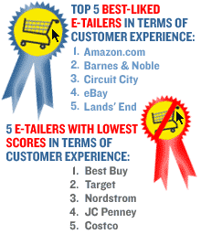
Online customer experience

Slide 22
CRM software applications and customer experience
Usability
Flexibility
High performance
Scalability

Slide 23
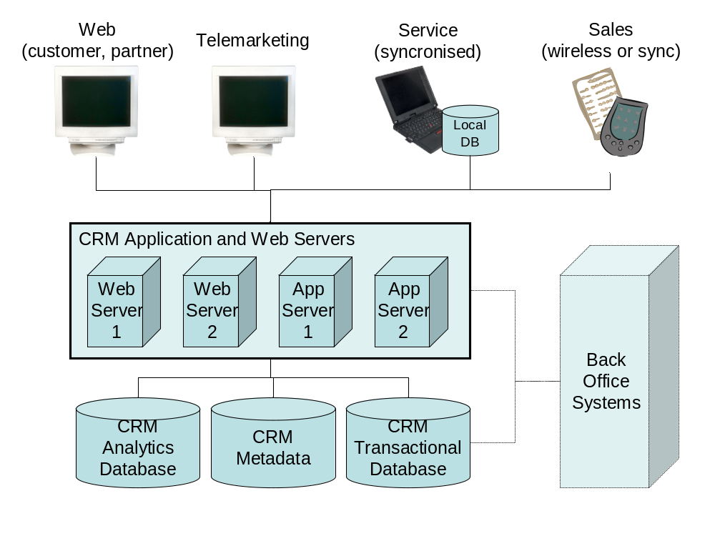
Typical CRM architecture

